Slide 1
Wireless and Mobile NETWORKING (CSE 570) Indoor Fingerprinting App
Supervised By, Submitted By,
Prof. Samir Das Alpit Kumar Gupta (110451714)
Deepak goyal (110347387) Vinayak Mittal (110385943)

Slide 2
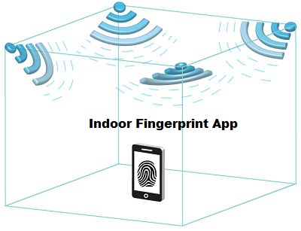
Objective
Implementation of Indoor localization methodology
Measure different indoor locations using cellular and Wi-Fi Signal information

Slide 3

Problem Statement
Current GPS system does not provide information regarding the position of indoor building system like mall, hospital, university etc.
Researcher wants to create fingerprint/database on its own

Slide 4
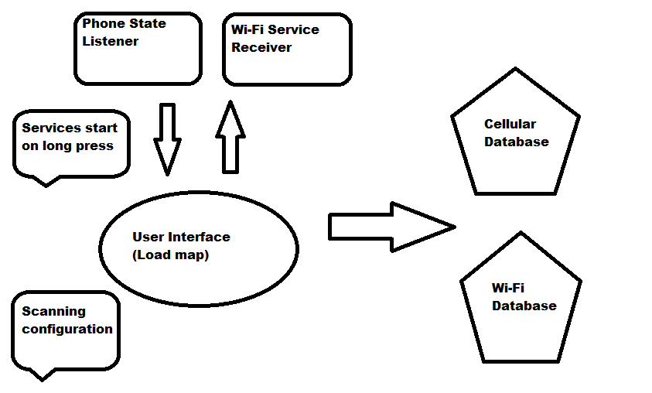
Our Solution: mobile android app

Slide 5
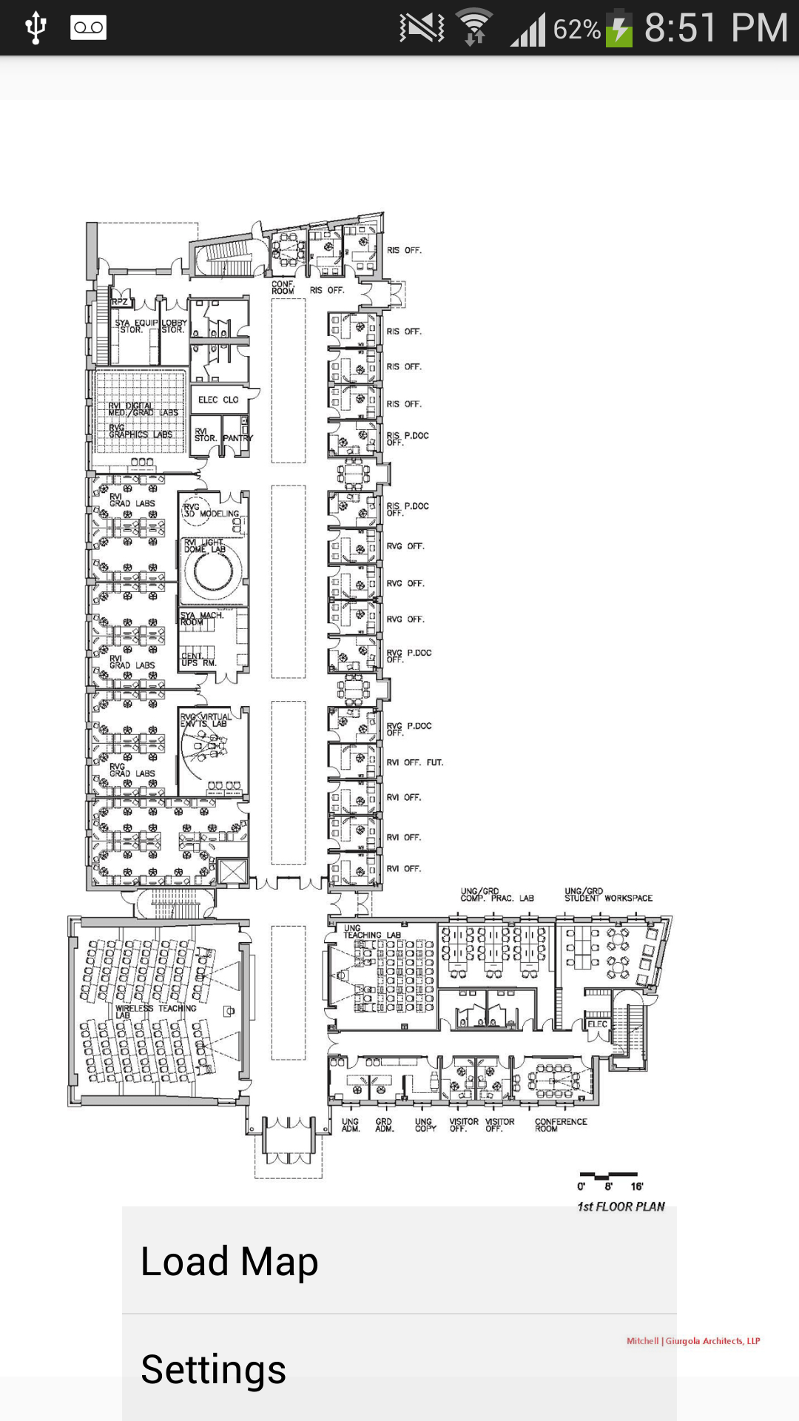
Load Map from any storage
flexibility to load any map from internal/external storage drive

Slide 6
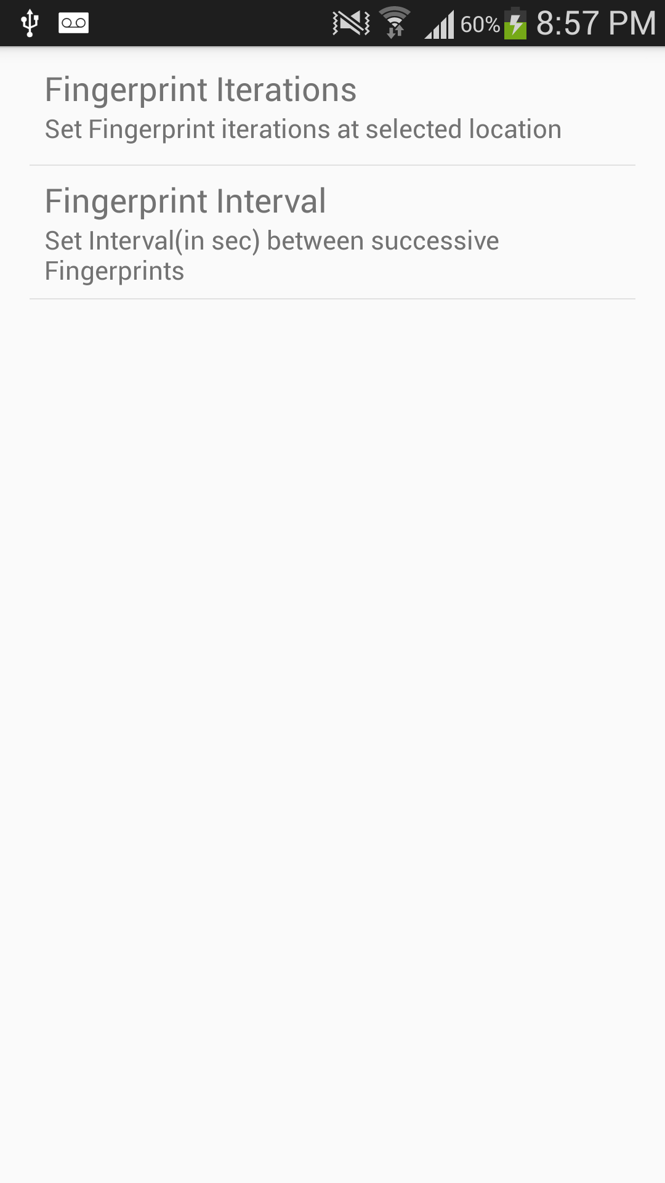
Set your Configuration:
# Scan iterations and time interval

Slide 7
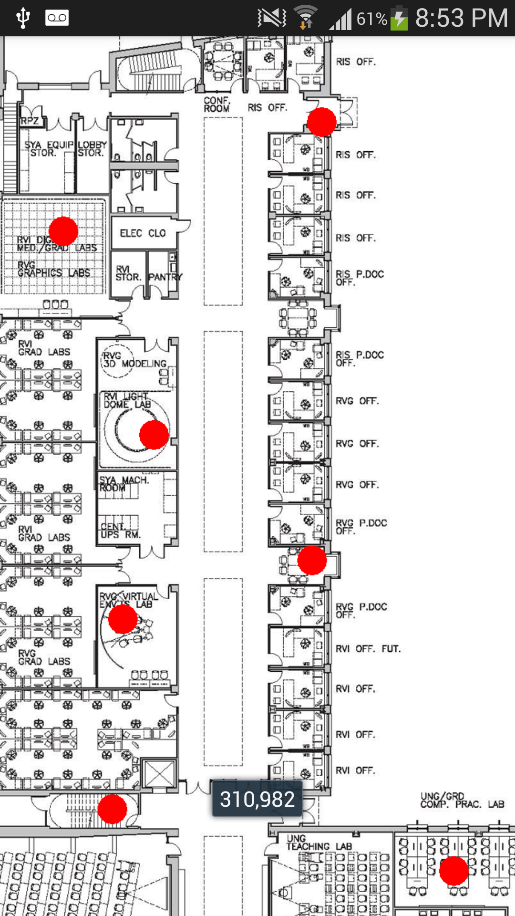
Start Fingerprinting…

Slide 8
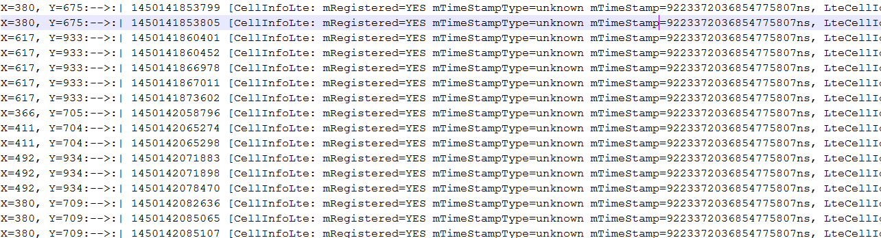
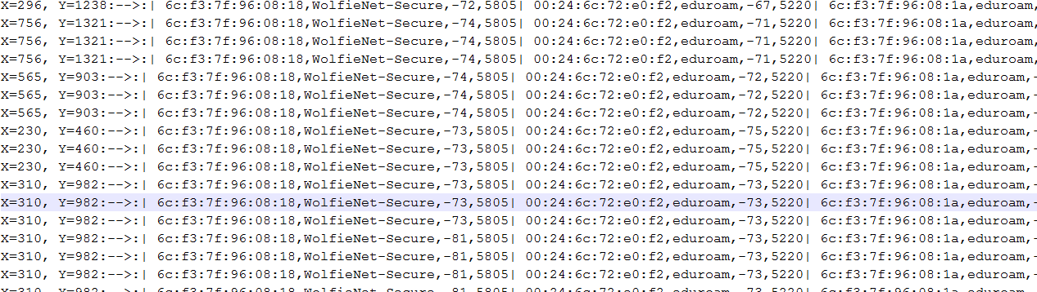
Database snippet…

Slide 9
Conclusion
robust and flexible tool for researcher which will help in creating indoor fingerprinting database
Application has been tested in different indoor locations and prepared database successfully
All required UI validation and error scenarios are handled.
Around 2000 lines of code have been written to make the app robust and fulfil all the required needs

Slide 10

Thank you

